Slide 1
Billinger et al. Alien game
First, we are recreating Billinger et al. This should not be too hard. It is simply alien artwork. I think we will learn a lot from this in how to design a proper experiment.
I sought to make it seem as similar the original. The artwork layout may be changed, but I like the user interface concept I have developed. In implementation it would need to be tidier.

Slide 2
A note on compensation
While we can differentially award people for their performance, to me this seems unfair. I think it is best that we tell people something along the lines of, “if you perform at the top 10th percentile of previous participants then you receive a bonus of X.” Then we just say they performed well, and we hand them $X no matter what.
While economists might disagree with this setup (econ journals won’t publish any experimental studies that mislead participants), I think it still incentives people. Participants will have the belief of higher compensation for performance and given how random these landscapes can be, it seems fair.
It is an unresolved lie when we say they performed in the top 10% and don’t tell them they did not perform that well. However, I am concerned that then individuals in online recruiting forums (for whatever platform we host this experiment on) may share this knowledge that everyone gets a bonus, and so later recruits won’t be incentivized to perform well. This a lie that really is minor and should not be anything an IRB will be concerned about.

Slide 3
Experiment Setup
First we ask for informed consent, then we present instructions.
Subjects are shown a page where they can click edit the alien artwork (see next page)
Simple interface: Users click a shape to toggle its display. Un-displayed shapes are opaque buttons and not shown up top as the focal artwork.
Billinger et al. had “10 geometric shapes, with one in each row”, I don’t think we need the same display, I have two rows of 5 shapes here. That seems intuitive and user friendly to me.
Users can easily fiddle with the shapes.
Users can see all their previous decisions on the right-hand side of the page.

Slide 4
Consent
You are invited to participate in a research study on decision making and optimal search in complex environments. You will be asked to design an artistic product for a hypothetical market. Your participation will take approximately <insert duration/>.
There are no risks to participating, and you will receive a guaranteed minimum compensation of $Y
If you have read this form and have decided to participate in this project, please understand your participation is voluntary and you have the right to withdraw your consent or discontinue participation at any time without penalty or loss of benefits to which you are otherwise entitled. The alternative is not to participate. The results of this research study may be presented at scientific or professional meetings or published in scientific journals. Your individual privacy will be maintained in all published and written data resulting from the study. We do not collect any personally identifying data in this study.
If you have any questions, concerns or complaints about this research, its procedures, risks and benefits, contact <<INSERT CONTACT>>.
If you are not satisfied with how this study is being conducted, or if you have any concerns, complaints, or general questions about the research or your rights as a participant, please contact the Stanford Institutional Review Board (IRB) to speak to someone independent of the research team at (650)-723-2480 or toll free at 1-866-680-2906, or email at IRB2-Manager@lists.stanford.edu. You can also write to the Stanford IRB, Stanford University, 1705 El Camino Real, Palo Alto, CA 94306.

Slide 5
My comments on consent
I do not think we need IRB approval (if so it can be expedited). If we do not need approval then we can drop the last paragraph of the consent form. Still I think we should include most of what I wrote.

Slide 6
Instructions (what users will see)
MAKE INTO VERY CONCISE BULLET POINTS. Perhaps sequence of screenshots
In this study, we are asking you to design an artistic product. However this product will be sold not to people but to alien life forms who do not share our conception of what is good artwork. Alien artwork is based upon geometric shapes. You will be given 10 distinct geometric shapes, each of which you may choose to include in your piece of artwork.
You will be given 25 opportunities to design a piece of artwork. You will sequentially submit each design and immediately learn how much an alien would be willing to pay for that piece of artwork. Your goal is to design a piece of artwork that will receive the highest price. If you perform better than top 10 percent of individuals who have already taken this study, then you will receive an extra $<x/> dollars. We will use your best performing piece of artwork to calculate who are the top performers.
Below is a screenshot of the user interface which you will see on the next page. At the top of the page, your current artwork design is displayed. There are two rows of shapes beneath it, you may click on a shape to toggle whether or not it is used in the current design. Clicking the “Submit Art” button ends your current round and on the “history” board on the right-hand side of the page you will see the payoff for that design highlighted. As you create more designs, they will be added to your history, which you may view at any time, with the most recent designs at the top. Your current round is displayed in the top left corner.
<Insert Screenshot of user interface>

Slide 7
Sample of three trials:
The following slides show what I imagine three trials to seem like as the user will see on a webpage. Starting after the first submission.
As in Billinger et al., whatever the first trial setup is, it should be the lowest point on our landscape.

Slide 8
History
Trial No. 1/25
Score
Combination
Click shapes to toggle
SUBMIT ART

Slide 9
History
Trial No. 2/25
Score
Combination
12.5
Click shapes to toggle
SUBMIT ART

Slide 10
History
Trial No. 3/25
Score
Combination
22.9
12.5
Click shapes to toggle
SUBMIT ART
SUBMIT ART

Slide 11
History
Trial No. 4/25
Score
Combination
23.2
22.9
Click shapes to toggle
12.5
SUBMIT ART

Slide 12
Notes on the design
I think we should highlight the payoff/score of the most recent decision. This makes it clear to the user what they just did
Furthermore we should display the actual shapes used in the history.
I include “Click shapes to toggle” as a friendly and constant reminder and a constant divider between the focal artwork and the toggling buttons.
Shapes are various colors so that it is easier and clearer for the users to manipulate the correct shapes, and it makes it easier to have color overlaps.

Slide 13
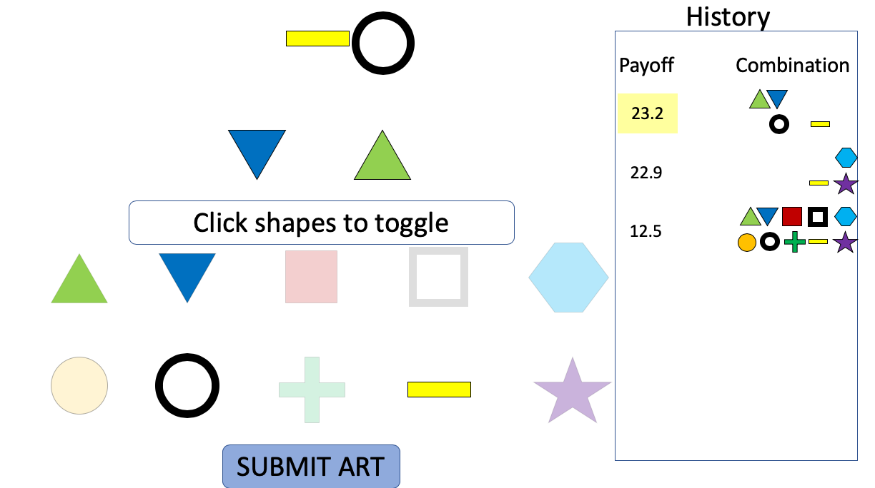
History need not be javascript. But it can be. Those values can be stored at every submit and then displayed. We can just pass up to previous combinations as sequences of 1 or 0 to toggle shape displays and pass the payoffs
INSERT TIME STAMP; See how they interact with scrollable history
The shape portion where it is displayed and toggled can be in javascript.
There are 10 shapes, we can have 2 images for each, an opaque one and a non-opaque one. We display them based upon toggling. Which then also simultaneously display up top.
Psuedo code:
IF CLICK THEN DISPLAY/HIDE IMAGE IN LAYOUT AND DISPLAY OPAQUE/FULL IMAGE SELECTION
The submit button will “refresh” the page. We take in values from the javascript. We save those values somewhere. As the page refreshes, we calculate the payoffs by finding their value in some csv. This way people can’t find values by inspecting the javascript. See pseudo code on right
IF SUBMIT: SAVE JAVASCRIPT SHAPE ARRAY;
MAP ARRAY TO SAVED FITNESS VALUES in GETFITNESS_FUNC(VALUES, LANDSCAPE);
APPEND VALUES AND FITNESS TO HISTORY ARRAY;
RELOAD PAGE DISPLAYING HISTORY AND INITIALIZE JAVASCRIPT WITH MOST RECENT VALUES

Slide 14
Why Have a Submit button that appears as “refreshing”?
I believe that hitting submit as a refresh will prevent people from gaming javascript while not getting rid of continuity in the user experience. As they cannot search the page for the values in javascript.
Upon refresh the previous artwork is still displayed as initial values for the ‘refreshed’ page , since we saved those values and will pass them on. A sense of continuity is maintained
If something goes wrong, then we have previous decisions stored.

Slide 15
End of Experiment Page (what users see)
Tell them what the maximum possible score was, how they did, and their bonus.Saying this makes it feel more fair as they know how they did.
Thank you for participating, your responses and highest scores have been reported. You were in the top 10 percent of performers and so you will receive an extra <$x/>.
We greatly appreciate your participation. This study sought to understand how individuals search for optima under complex decision-making. If you have any comments about this research please put them in the comment box below.
<Insert comment box>

